Slide 1



Slide 2


GROUP NO : 9
MUSA BIN ABDULLAH 233576
M.DANIAL 233588
M.MUZAMIL 233514
M.ARBAB 233578
M.JAVED 233546

Slide 3
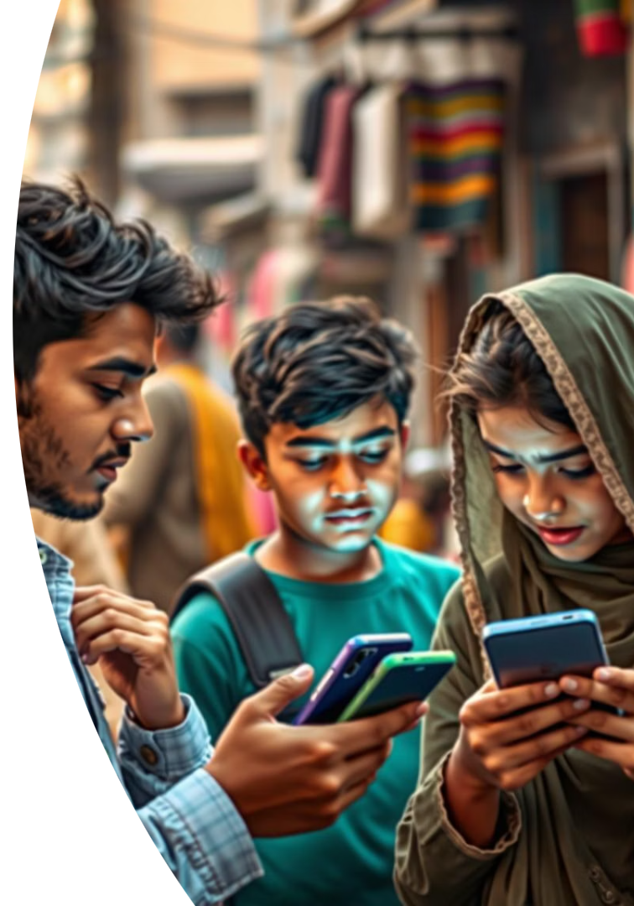
Plan to Minimize the harmful effects of use of Social Media
A Plan to Reduce Social Media Use means a
clear set of steps and ideas to help young people
spend less time on social media. The goal is to
improve their mental health, help them focus
better, be more productive, and spend more
time in real-life activities and face-to-face
interactions.

Slide 4
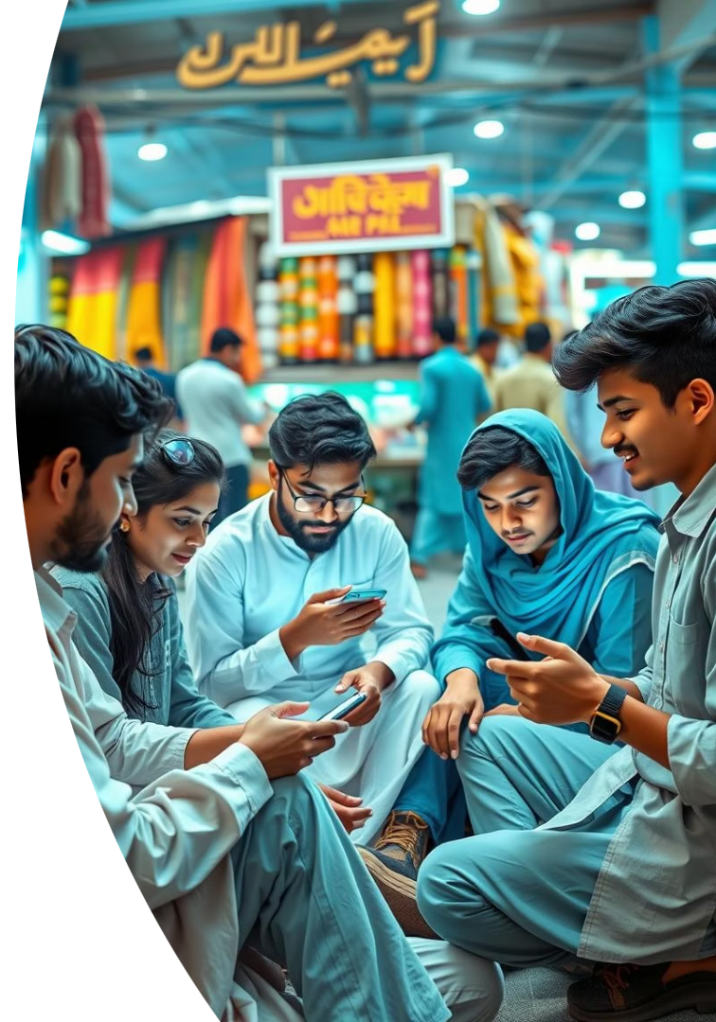
Why This Matters: Social Media Use in Pakistan
Understanding the daily social media engagement among Pakistani youth and adults is crucial to addressing its impact.
75.9%
92%
38.9%
Youth Daily Use
Teen Online Daily
Adult Social Media Users
Pakistani youth report daily social media engagement.
Pakistani teenagers internet users go online every day.
Adults in Pakistan actively use social media platforms.
Source: DataReportal 2024, Pakistan Journal of Social Research,
Gallup Pakistan

Slide 5




Civic Awareness and Attention Span: A Growing Concern
Social media also affects young people's ability to take part in civic activities, like helping their
communities or staying informed about important issues.
Distracted from Community
Youth often disengaged from real-world civic participation.
Reduced Reading Skills
Lower comprehension and less time spent on deep reading.
Shallow Information
Preference for quick, superficial content over detailed analysis.

Slide 6
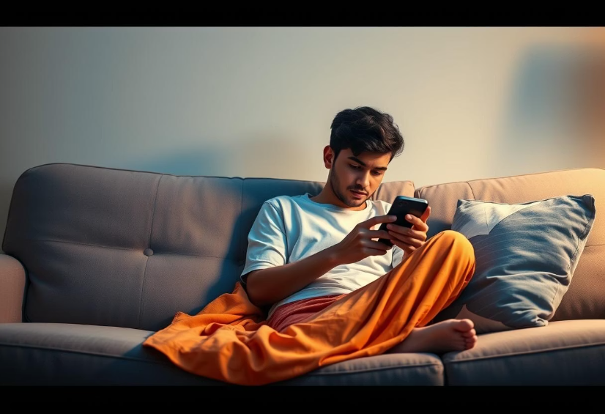
Physical Health Danger #1: Inactive Lifestyle
Excessive phone use contributes to a Inactive lifestyle,
leading to various physical ailments.
4+ hours phone use daily:
Linked to muscle Weakness.
Poor posture: Affects spinal
health
Tip: Regular movement breaks
are essential
Chronic back pain: A common result of prolonged sitting

Slide 7





Physical Health Danger #2: Poor Sleep Quality
Nighttime phone use significantly disrupts sleep patterns and overall well-being.
Nighttime Phone Use
Blue light from screens interferes with melatonin production.
Phones in Bed
One-third of youth sleep with their phones nearby.
Disrupted Sleep Cycle
Affects natural sleep-wake cycle.
Tip: Avoid Screen Time
No screens one hour before bedtime for better sleep.

Slide 8
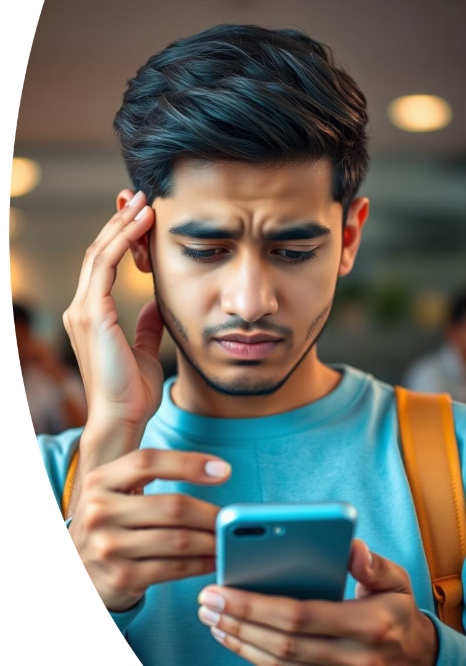
Mental Health Danger #1: Social Media Addiction
The rewarding nature of social media can lead to addictive behaviors, similar to other dependencies.
Rewarding Sensation
Similar brain activity to gambling or substance use.
Tip: Set Limits
Implement screen time boundaries and take regular app-free breaks.

Slide 9
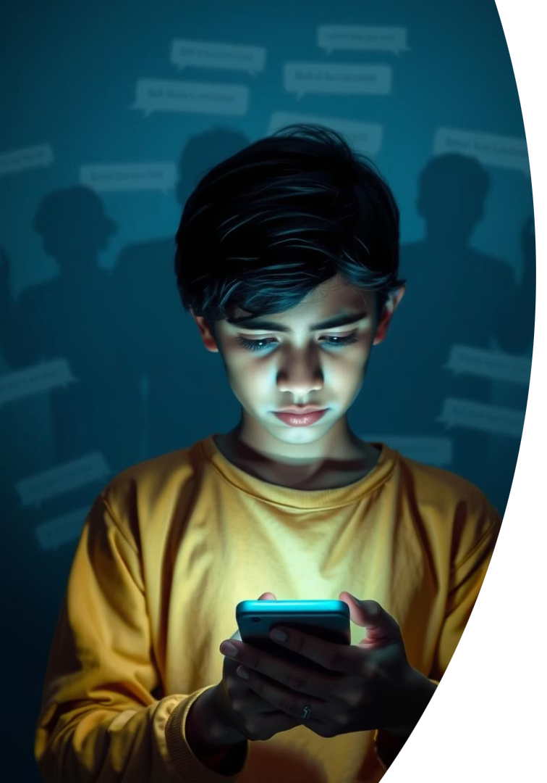
Mental Health Danger #2: Cyberbullying
Cyberbullying is a prevalent issue affecting the self-esteem and mental well-being of young people.
Widespread Issue
Over 50% of youth have experienced online bullying.
Harm to Self-Esteem
Negative impact on confidence and self-worth.
Mental Health Deterioration
Leads to anxiety, depression, and stress.
Tip: Block, Report, Seek Help
Take immediate action and reach out for
support.

Slide 10




Mental Health Danger #3: Less Time with Real People
Increased online interaction often replaces crucial face-to-face communication,
impacting social skills.
Replaced by Online
1
Digital interactions substitute real-life conversations.
Affects Empathy
2
Reduced ability to understand others' feelings.
Weakened Bonding
3
Less strong interpersonal connections.
Impaired Communication
4
Diminished verbal and non-verbal social skills.

Slide 11
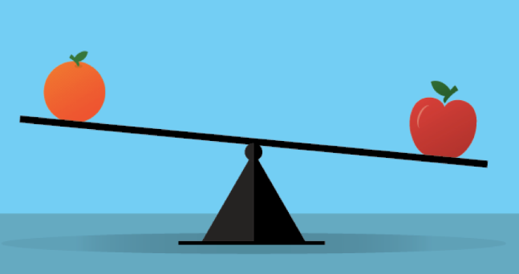
Mental Health Danger #4: Unhealthy Comparisons
Social media encourages people to compare their own lives to the best moments others
choose to share.
Self-Doubt
Jealousy
Unhappiness
Motivation
Social media often presents only the best moments, leading to unrealistic perceptions and negative self-assessment.

Slide 12

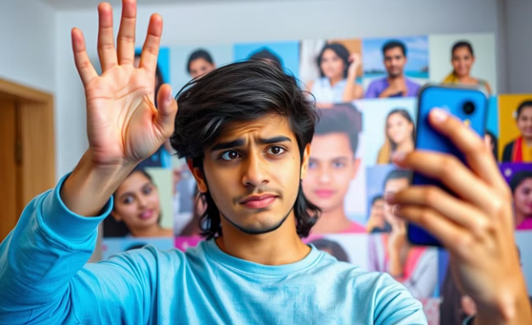

Mental Health Danger #5: Harming Your Self-Image
Filters make people believe they have to look perfect, which isn’t real.
Seeing only perfect moments online makes people expect too much from real life.
Instagram’s own study showed that young people feel worse about themselves.
Using filters and showing only perfect images online makes beauty standards unrealistic and
lowers self-confidence.

Slide 13

Content Danger #1 : Fake News
Rapid Spread
False stories spread faster than
real ones
Misleading Information
Users misled about health, politics,
finances

Slide 14

Content Danger #2 : Scams
Phishing Scams
Charity and Disaster Relief Scams
You get a message or see a post with a strange link. It may say things like “Click here to win a prize” or “Your account has a problem.” To trick you into giving your password, credit card number, or other private information.
Scammers create fake accounts or ads asking people to donate money after something bad happens, like a flood, earthquake, or war. They pretend to be a real charity. To steal money that kind people think they are giving to help others.

Slide 15




Content Danger #3: Risky Behaviors
Dangerous Challenges
Online pranks and challenges encourage unsafe acts
Drug Normalization
Illegal activities presented as appealing
Copycat Behavior
Youth replicate seen risky behaviors

Slide 16





Content Danger #4: Inappropriate Content
Adult Content
Unwanted exposure to explicit content
Hate Speech
Encountering abusive language
Use Filters
Proactive content filtering
3
Report Bad Content
Violence
Exposure to graphic content
2
4
Empower users to report harmful material
1
5

Slide 17
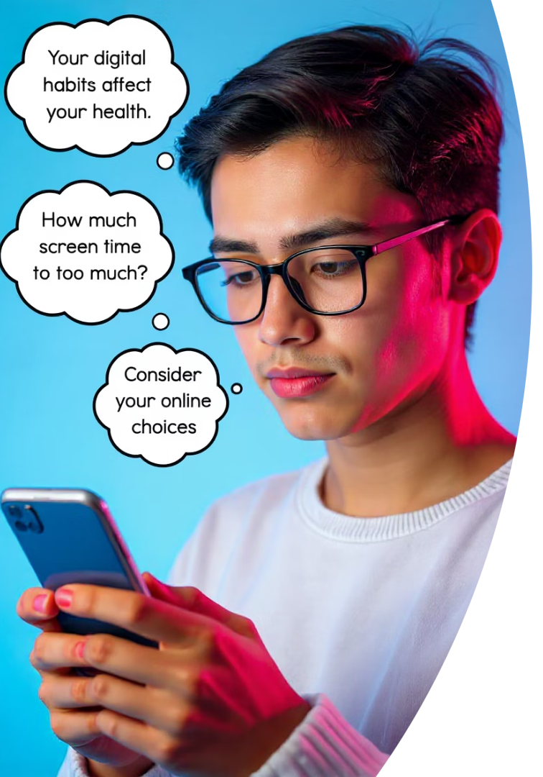
The Plan - Step 1: Be Aware of Your Habits
1
Usage Patterns
Identify when and where social media is
used
2
Motivations
Understand reasons like boredom or
habit
3
Post-Use Feelings
Reflect on emotional states after use

Slide 18
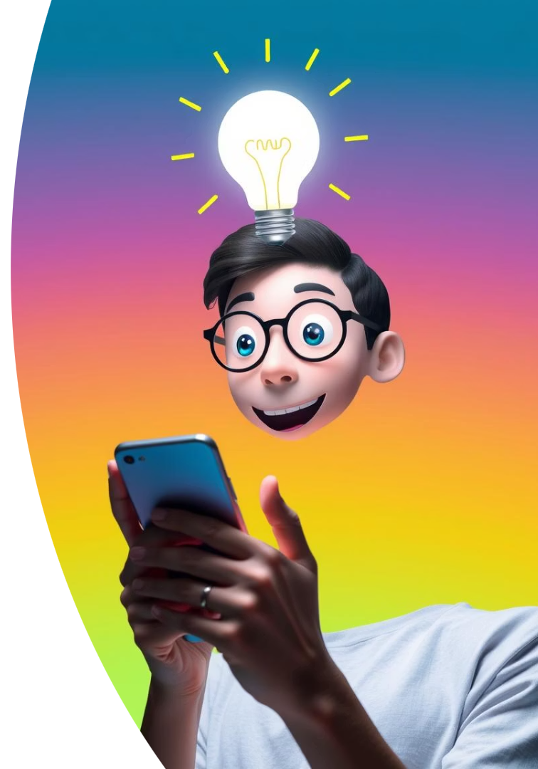



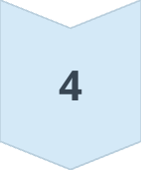
The Plan - Step 2: Understand What You Really Need
Connection
Seeking genuine interaction?
Validation
Craving external approval?
Escape
Using it to avoid reality?
Emotional Triggers
Recognize what drives usage

Slide 19
The Plan - Step 3: Try Healthier Alternatives
Need
Better Option
Connection
Talk to family, join club
Validation
Share wins in real life
Entertainment
Read, paint, play sports
Coping
Breathe, journal, exercise

Slide 20






The Plan - Step 4: Handle the Urge to Check
Blank Screen
Visualize a blank screen to deter checks
5 Senses Trick
Grounding technique for mindfulness
Daily Gratitudes
Write three things you're grateful for

Slide 21
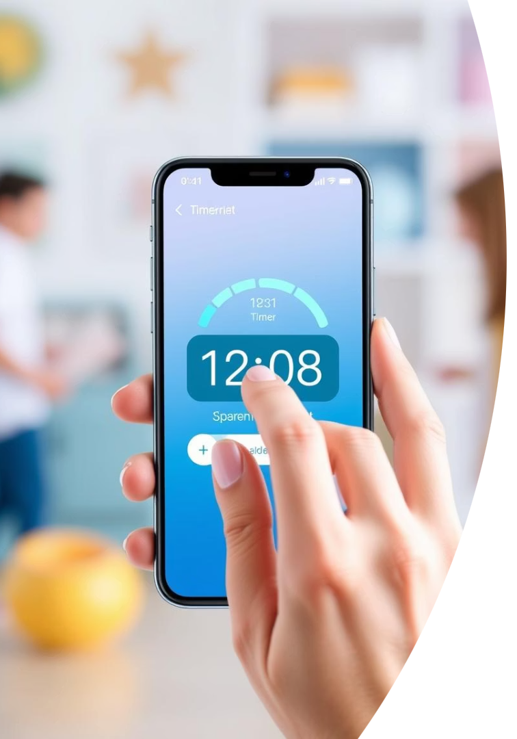
The Plan - Step 5: Take Control Gradually
Set Time Limits
Utilize apps for managing usage
Morning Phone Ban
Avoid checking phone upon waking
Mute Notifications
Turn off alerts during meals

Slide 22
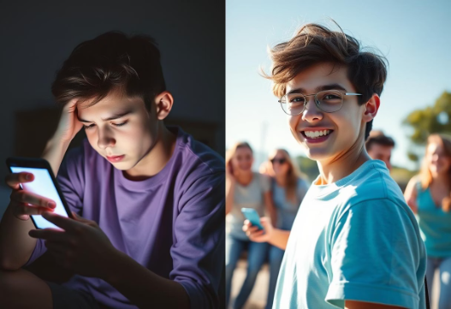
Before vs. After: Reclaiming Our Time
Before: Social Media Overload
After: Balanced Digital Life
2 hours daily screen time
6+ hours daily screen time
Increased stress and
anxiety
Improved mental
wellbeing
Poor sleep patterns
Restful, consistent sleep
Reduced academic focus
Enhanced concentration
Weakened real-world connections
Stronger relationships and hobbies

Slide 23

Join the Movement: The 7-Day Challenge
Are you ready to take control of your screen time and discover a more fulfilling life? The 7-Day Challenge is designed to help you kickstart healthier habits and experience the positive changes firsthand.
Track Your Screen Time
Use an app or manual log to monitor daily
usage.
Replace with Healthy Habits
Swap social media scrolling for two new activities like reading, exercise, or spending time with loved ones.
Share Your Progress
Connect with friends and family to share your journey and inspire others.

Slide 24




Reclaim Your Time and Focus
Together, we can cultivate better minds, healthier bodies, and stronger communities.
Better Minds
Enhanced focus and reduced anxiety.
Healthier Bodies
More active lifestyles and better sleep.
Stronger Communities
Deeper real-world connections.

Slide 25


